Slide 1


December 2nd, 2025
1:00pm – 3:30pm
Oregon Conservation and Recreation Fund
Advisory Committee Meeting
Virtual Meeting

Slide 2
Agenda Item 1:
Review and Approve Meeting Minutes
(October 7th 2025)

Slide 3
Draft Motion Templates re: Minutes
I move to approve the October 7th, 2025 meeting minutes with the continued authority to correct spelling, grammar, and punctuation.
I move to approve the October 7th, 2025 meeting minutes with the addition/correction/ deletion of ____ on page ___, line ____, and continued authority to correct spelling, grammar, and punctuation.

Slide 4
Agenda Item 2:
OCRF Project Presentation: Oregon Wildlife Foundation to present on the Portland Urban Wildlife Information Network (UWIN PDX) project.
Tim Greseth, Executive Director, Oregon Wildlife Foundation

Slide 5
Agenda Item 3:
OCRF Project Presentation: Westwind Stewardship Group to present on “Westwind Camp Scholarship Program” project.
Andy Lindberg, Executive Director, Westwind Stewardship Group

Slide 6
Agenda Item 4:
Public Comment

Slide 7
Agenda Item 5:
Break
(Please be back in 10 min)

Slide 8
Round 10 Winter 2025/2026 Application Review and Updates
Agenda Item 6:

Slide 9
Round 10 Winter 2025/2026 Application Review and Updates
Language updated throughout: start/end dates,*all drought funding language removed, character limits reduced
Grant cap updated to $25,000
OCRF Requested Funds moved up top
Budget Section moved up
Added conditional logic for ground disturbance projects: SHPO case number upload

Slide 10
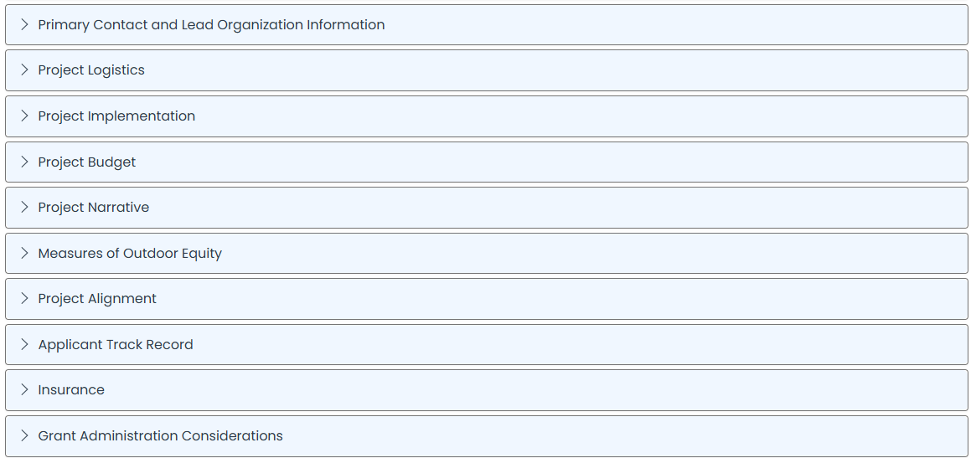
Round 10 Winter 2025/2026 Application Sections

Slide 11
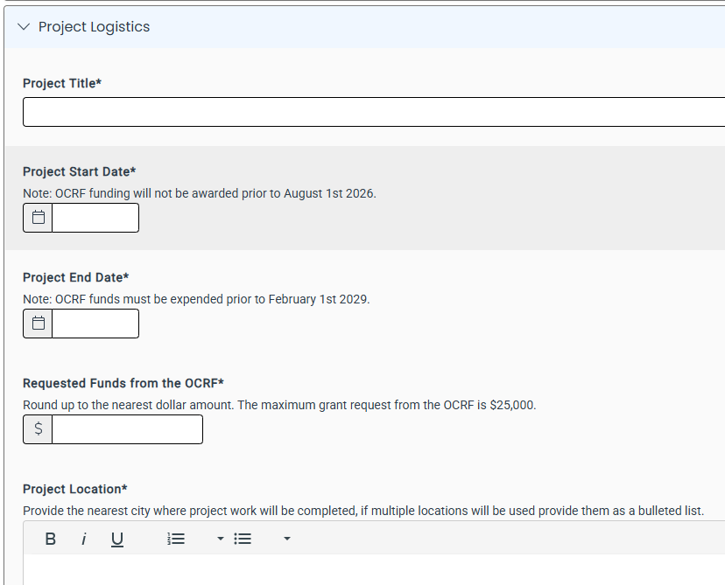
Round 10 Winter 2025/2026 Application Review and Updates

Slide 12
Round 10 Winter 2025/2026 Application Review and Updates
**OCRF Requested Funds moved up top

Slide 13
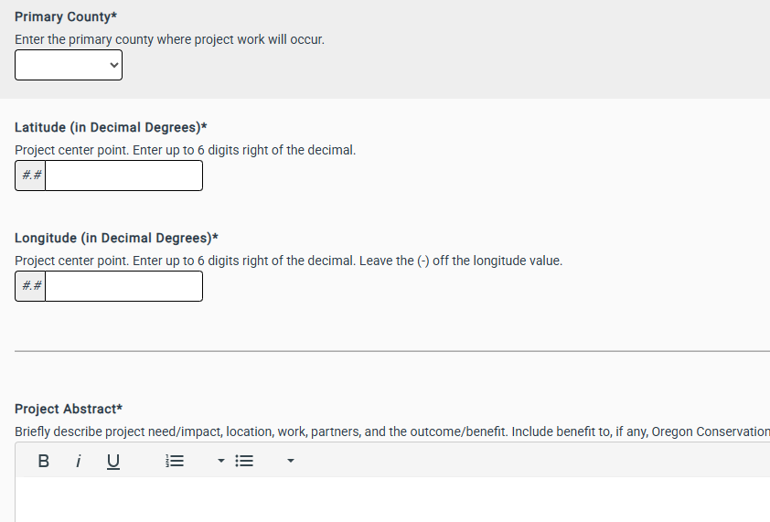
Round 10 Winter 2025/2026 Application Review and Updates
**OCRF Requested Funds moved up top

Slide 14
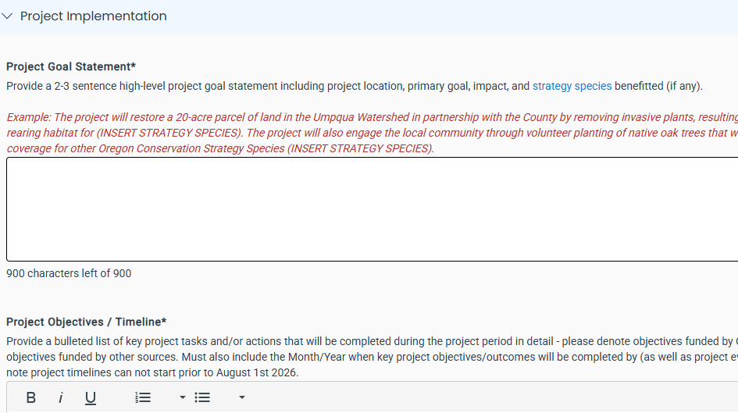
Round 10 Winter 2025/2026 Application Review and Updates

Slide 15
Round 10 Winter 2025/2026 Application Review and Updates
**Project Objectives combined with Project Timeline

Slide 16
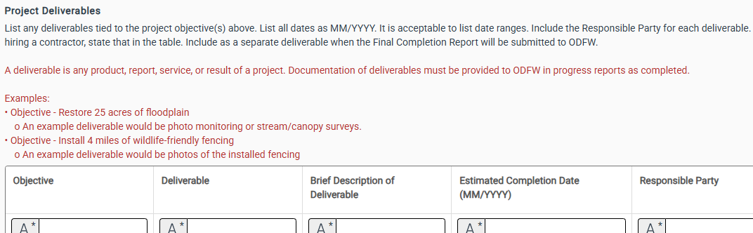
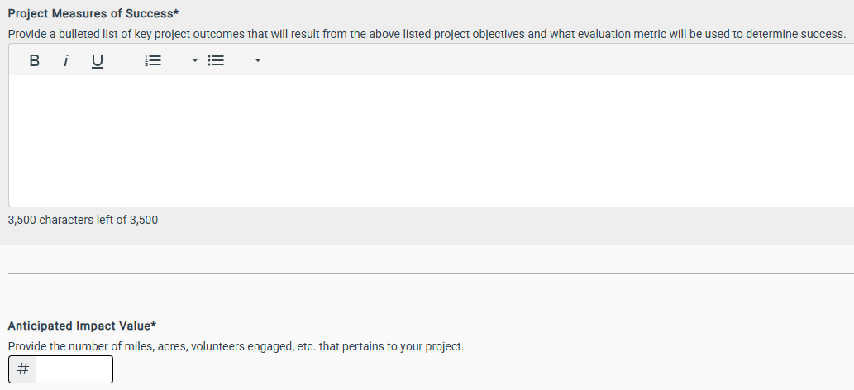
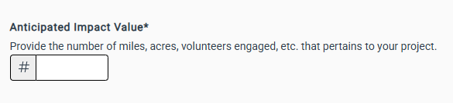
Round 10 Winter 2025/2026 Application Review and Updates

Slide 17
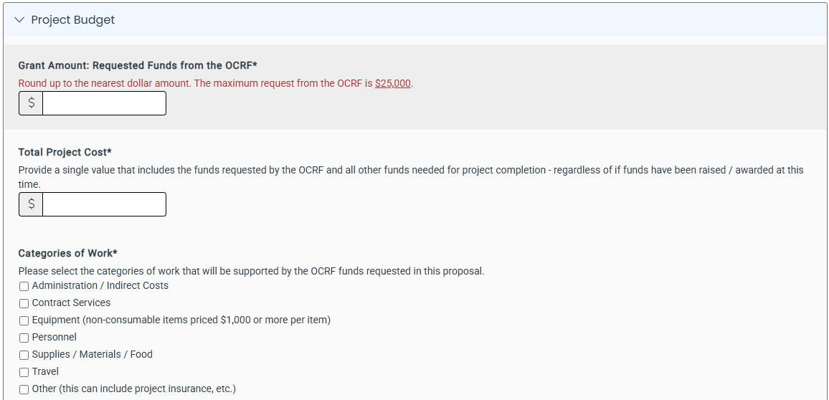
Round 10 Winter 2025/2026 Application Review and Updates

Slide 18
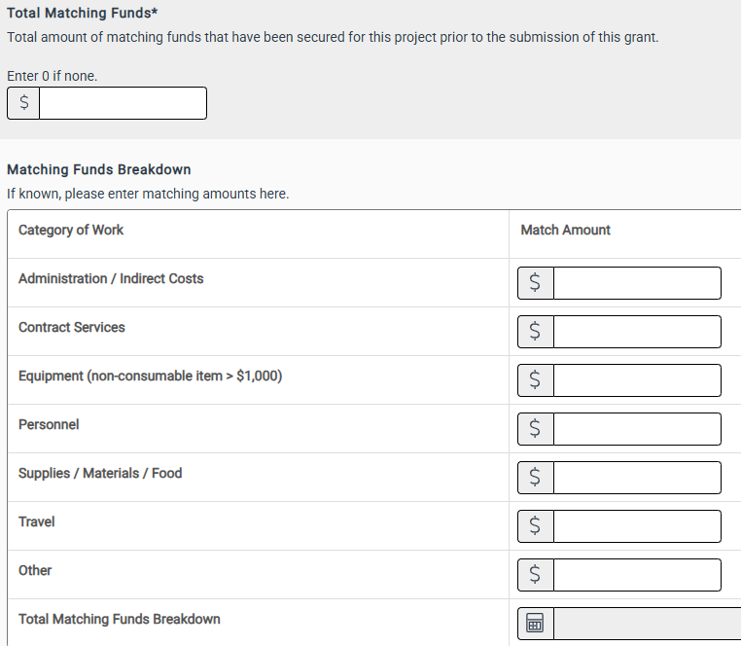
Round 10 Winter 2025/2026 Application Review and Updates

Slide 19
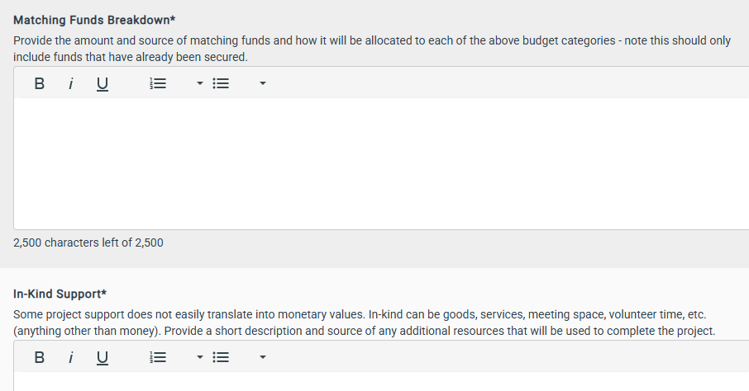
Round 10 Winter 2025/2026 Application Review and Updates

Slide 20
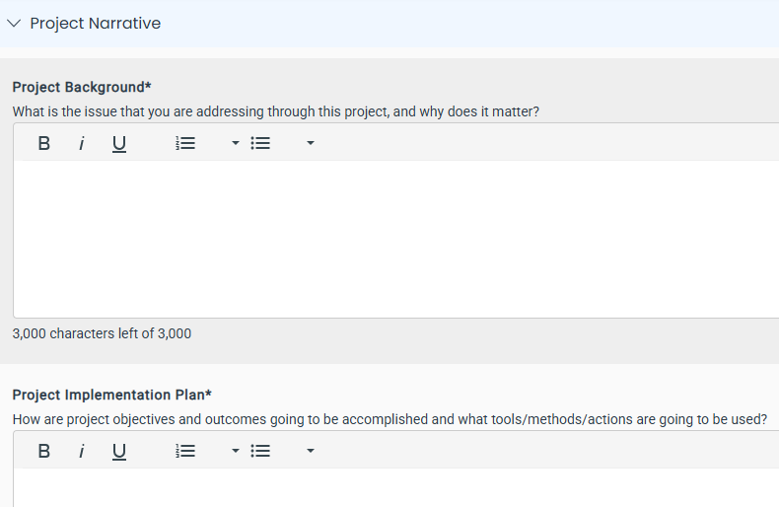
Round 10 Winter 2025/2026 Application Review and Updates

Slide 21
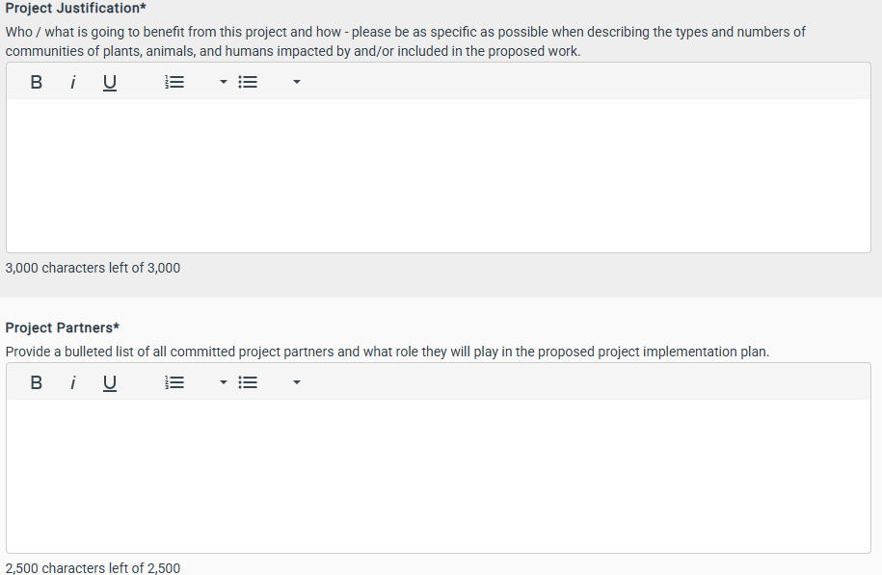
Round 10 Winter 2025/2026 Application Review and Updates

Slide 22
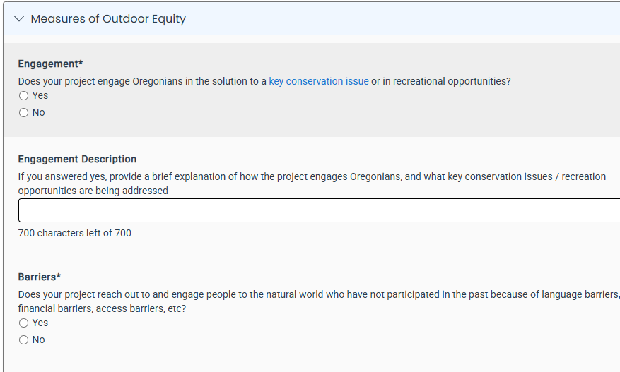
Round 10 Winter 2025/2026 Application Review and Updates

Slide 23
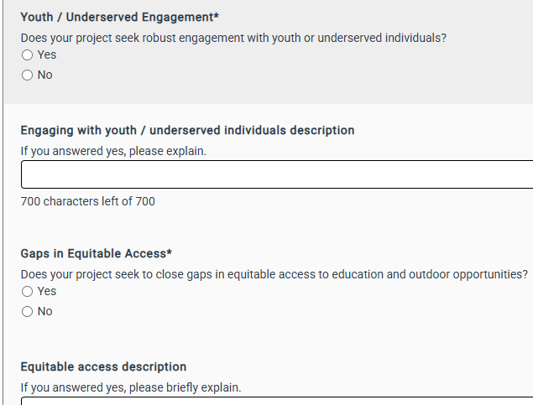
Round 10 Winter 2025/2026 Application Review and Updates

Slide 24
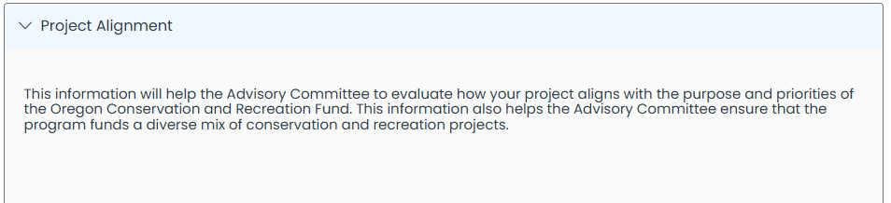
Round 10 Winter 2025/2026 Application Review and Updates
**No Changes Made to Project Alignment section, **Updates coming 2026 once SWAP website is live

Slide 25
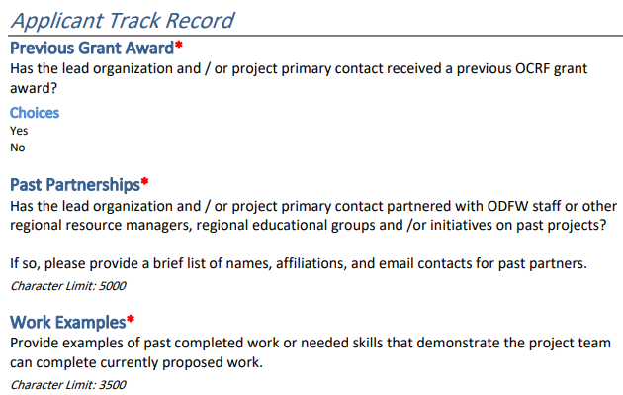
Round 10 Winter 2025/2026 Application Review and Updates

Slide 26
Agenda Item 7:
OCRF Effectiveness Monitoring

Slide 27
Agenda Item 8:
OCRF Business Items
*Legislative Update

Slide 28
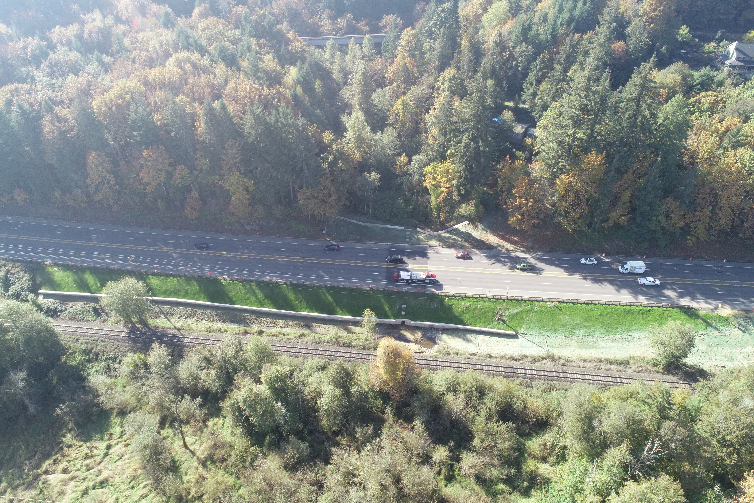
Wildlife Connectivity Funding
ODOT Funding swap - Not off the table
Funding swap could allow for less restrictive wildlife crossing funds

Slide 29
OCRF Spring 2025 RFP - Timeline
Request for Proposals (RFP) – Open March 20th, 2025
Official RFP Guidance made public (open for 50 days)
Request for Proposals (RFP) – Close May 9th, 2025
Technical Review Period – May 16th - June 16th, 2025
OCRF Advisory Committee Review Period – June 17th - July 15th, 2025
(Release early – more lead time)
OCRF Advisory Member follow-ups w/ tech reviewers – July 9th – 11th
Opportunity for OCRF Advisory Members to have Q/A with the ODFW technical reviews on an as needed basis
OCRF Advisory Committee Recommendations – July 29th, 2025 meeting
ODFW Commission Voting – September 12, 2025
Release of funds following contracting process – November 2025

Slide 30
OCRF Winter 2025/2026 RFP - Timeline
Request for Proposals (RFP) – Open December 15th, 2025
Official RFP Guidance made public (open for 8 weeks)
Request for Proposals (RFP) – Close February 9th, 2026
Technical Review Period – Feb 16th - March 27th, 2026
OCRF Advisory Committee Review Period – March 13th - April 17th, 2026
(Release early – more lead time)
OCRF Advisory Member follow-ups w/ tech reviewers – April 14th – 16th
Opportunity for OCRF Advisory Members to have Q/A with the ODFW technical reviews on an as needed basis
OCRF Advisory Committee Recommendations – May 5th, 2026 meeting
ODFW Commission Voting – June 18, 2026
Release of funds following contracting process – August 2026

Slide 31
Upcoming Meetings
This Meeting: December 2nd 1-4pm
^{Application workshop}
2026 Meetings (Every other Month, First Tuesday of the Month)
Mar 3, 2026
May 5, 2026: Round 10 Project Recommendations (In-person)
July 7, 2026
Sept 1, 2026
Nov 3, 2026

Slide 32
Agenda Item 10:
Meeting Wrap Up and Next Steps

Slide 33
OCRF Budget Update – Sep ‘25
Base Program: $810k
Remaining ELS donations of 25-27, additional ~$220k and future interest < current
Drought Package: $0
All Drought Package funds have been committed to projects
ARPA: $0
All Federal ARPA funds have been committed to projects
Wildlife Crossing Lottery Bonds: $ 3.93 million
Lottery Bond Sale occurred May 2025; $1,069,500 committed to projects

